Slide 1

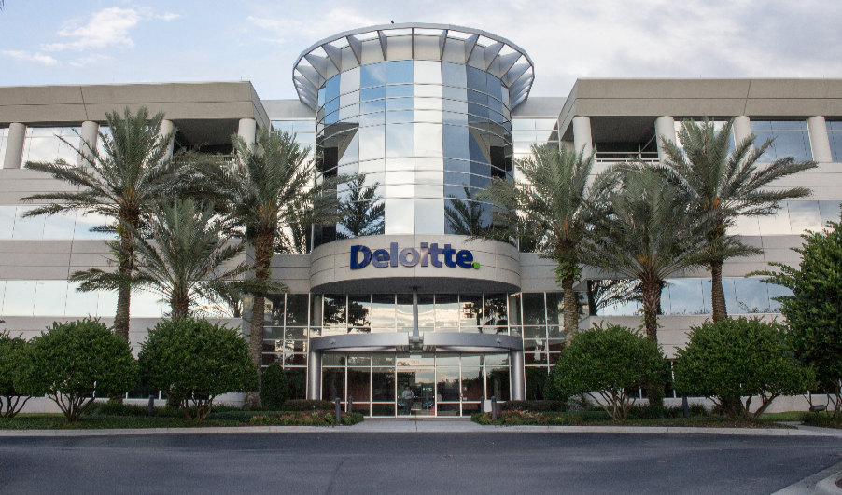
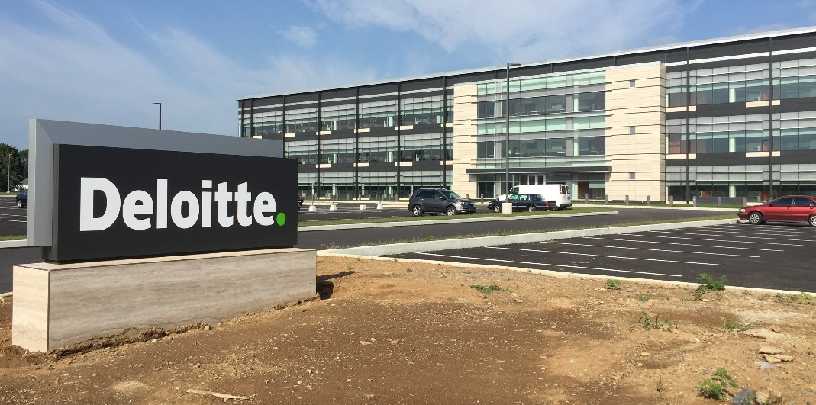
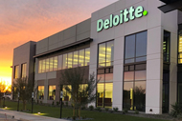
USDC Information Technology Center of Excellence (IT-CoE)
Topic: CompTIA Security+ Testing Review
Orlando, FL
Mechanicsburg, PA
Gilbert, AZ

Slide 2
Incident Response and Forensics
Session 11
Security+
CompTIA Security+
Test: SYO-601
EXAM OBJECTIVES (DOMAINS)
The table below lists the domains measured by this examination and the extent to which they are represented:
Domain | Weight
1.0 Threats, Attacks and Vulnerabilities | 24%
2.0 Architecture and Design | 21%
3.0 Implementation | 25%
4.0 Operations and Incident Response | 16%
5.0 Governance, Risk, and Compliance | 14%
Total | 100%
Session 11
Includes Objectives from Domain 1 and 5
Objective 1.4 – Explain penetration testing concepts.
Objective 1.5 – Explain vulnerability scanning concepts.
Objective 5.4 – Given a scenario, follow incident response procedures.
Objective 5.5 – Summarize basic concepts of forensics.
Objective 5.6 – Explain disaster recovery and continuity of operation concepts.

Slide 3
Incident Response and Forensics
Session 11
Security+
Terminology
Cold Site – A physical site that can be used if the main site is inaccessible(destroyed) but that lacks all of the resources necessary to enable an organization to use it immediately.
Disaster Recovery – The act of recovering data following a disaster in which it has been destroyed.
Forensics – The act of looking at all of the data at your disposal to try and understand who gained unauthorized access and the extent of that access.
Hot Site – An alternate location that can provide operation within hours of a failure.
Intrusive Tests – Penetration-type testing that involves trying to break into a network.
Offsite Storage – Storing data off the premises, usually in a secure location.
Tabletop Exercise – An exercise that involves individuals sitting around a table with a facilitator discussing situations that could arise and how best to respond to them.

Slide 4

Incident Response and Forensics
Session 11
Security+
Business Continuity
Business Continuity Planning (BCP)
The process to plan and prepare for potential interruptions in business processes and how to continue the delivery of products or services at acceptable levels following a disruptive incident.
The Business Continuity Plan’s goals are to maintain as much of the business operations as possible before and during the execution of the Disaster Recovery Plan.

Slide 5
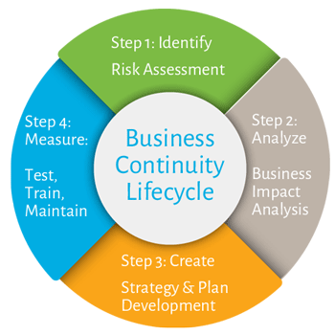
Incident Response and Forensics
Session 11
Security+
Business Continuity
Business Continuity Planning (BCP)
Perform Risk Assessment – Evaluate the risk and likelihood of a business loss.
Create Business Impact Analysis – Evaluate the impact to the business of a loss.
Create Strategy and Plan Development – Create a plan for responding to a business loss.
Test, Train, Maintain – Test the response plan, train the personnel responsible for responding, and update the plan for ongoing changes.

Slide 6
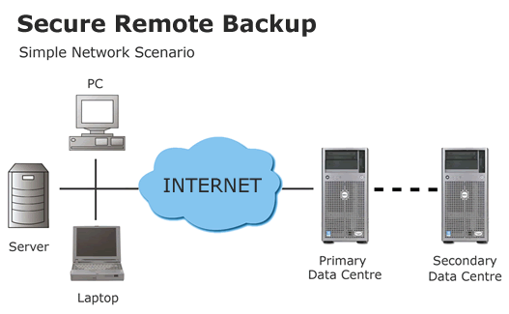
Incident Response and Forensics
Session 11
Security+
Business Continuity
Protecting Critical Business Data
Working Backups – Onsite data backups that are available immediately for data recovery.
Onsite Storage – An onsite data center location that stores most recent backup copies of business data. In the form of tapes, cartridges or backup media. This location should be fireproof, secure, and other ways protected.
Offsite Storage – Offsite location where backup copies of paper reports, and backup media are kept, in case of catastrophic losses at the onsite facility.

Slide 7
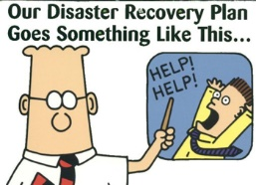
Incident Response and Forensics
Session 11
Security+
Business Continuity
Disaster Recovery Plan (DRP)
Goal – Reestablishing IT services and minimizing losses.
Recovering from disasters:
Environmental
Man-made
Natural
Recovery Point Objective (RPO) – Point at which it is acceptable to recover data and resume operations. Maximum amount of data loss acceptable. This could be 5 minutes or 5 hours, or more.
Recovery Time Objective (RTO) – Amount of time acceptable to restore operations after a disaster, before significant business losses are incurred.

Slide 8
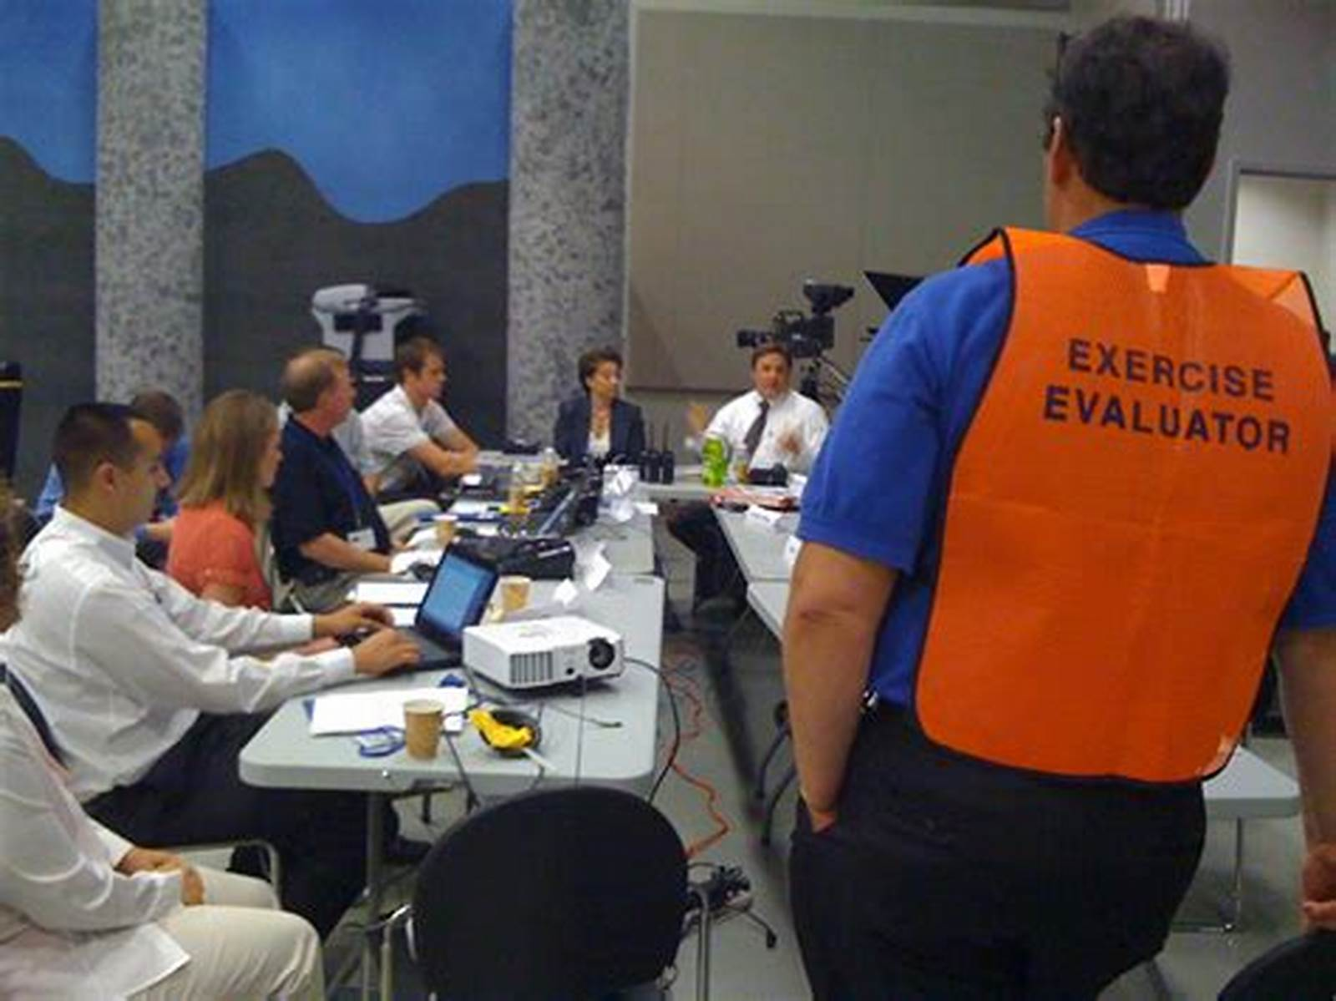
Incident Response and Forensics
Session 11
Security+
Business Continuity
Tabletop Exercise
A simulation of a disaster to validate the Disaster Recovery Plan.
Document Review – A review of recovery plans, operations plans and procedures.
Walkthrough – Group discussion of recovery plans and procedures
Simulation – Walkthrough of recovery plans and procedures with scripted case study.
Parallel Test – Test backup systems, but leave main systems running
Cutover Test – Do an actual cutover test to test the backup systems.

Slide 9
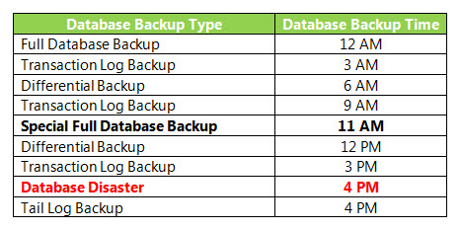
Incident Response and Forensics
Session 11
Security+
Business Continuity
Database Backup Plans
Full Backup – This is a complete backup of all database files.
Incremental Backup – A partial backup that stores all new data since the last full backup or the last incremental backup.
Differential Backup – A backup of all data that has been changed since the last full backup.
Hierarchical storage management (HSM) – Continuous backup of all database changes to a tape system or other storage media.

Slide 10
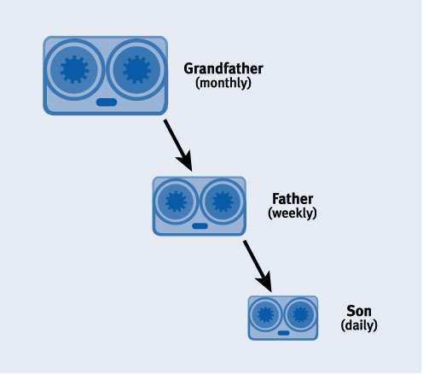
Incident Response and Forensics
Session 11
Security+
Business Continuity
Data Retention Policies
Grandfather – Oldest cycle of the full backup data, sent to Offsite facility each month and retained for a year.
Father – Kept in Onsite storage location, as full backup for the month.
Son – Full backup each week is the current full backup kept for immediate restore.
Annual – Annual full backups are made and sent to Offsite facility for long term storage.
Full Archival – This policy states that all data created on the system is stored forever.

Slide 11
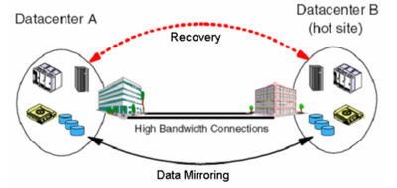
Incident Response and Forensics
Session 11
Security+
Business Continuity
Recovery Sites (COOP – Continuity of Operations Sites)
Hot Site – Another location that can provide the reestablishment of operations within hours of a failure.
Warm Site – Provides some of the capabilities of a hot site but requires more actions to bring the site up to full operational activities.
Cold Site – An alternate location that can be used in the event of a disaster but requires the customer to bring equipment and data backups to set up their data center.

Slide 12
Incident Response and Forensics
Session 11
Security+
Business Continuity
Knowledge Check 2
Which of the following would allow for the QUICKEST restoration of a server into a warm recovery site in a case in which server data mirroring is not enabled?
A. Full backup
B. Incremental backup
C. Differential backup
D. Snapshot

Slide 13
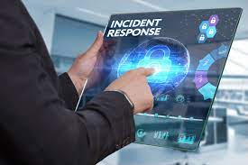
Incident Response and Forensics
Session 11
Security+
Incident Response
Incident Response
An organized approach to addressing and managing the aftermath and effects of a security breach or cyberattack, also known as an IT incident, computer incident or security incident, with a goal to limit damage and reduce recovery time and costs.
The Incident Response Plan determines the best response to incidents such as:
Denial of service
Data breaches
Hardware theft
Malicious software
Terrorist attacks
Physical intrusion
Unauthorized software

Slide 14
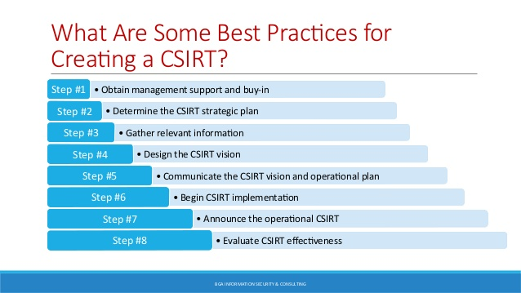
Incident Response and Forensics
Session 11
Security+
Incident Response
Computer Incident Response Team
Responsible for developing and implementing the company Incident Response Plan. Permanent members and on-call members.
With area experts in each of the computer network systems.
Members from all areas of the organization:
Human resources
Information Security
Legal
Network and systems administrators
Physical security
Public relations

Slide 15
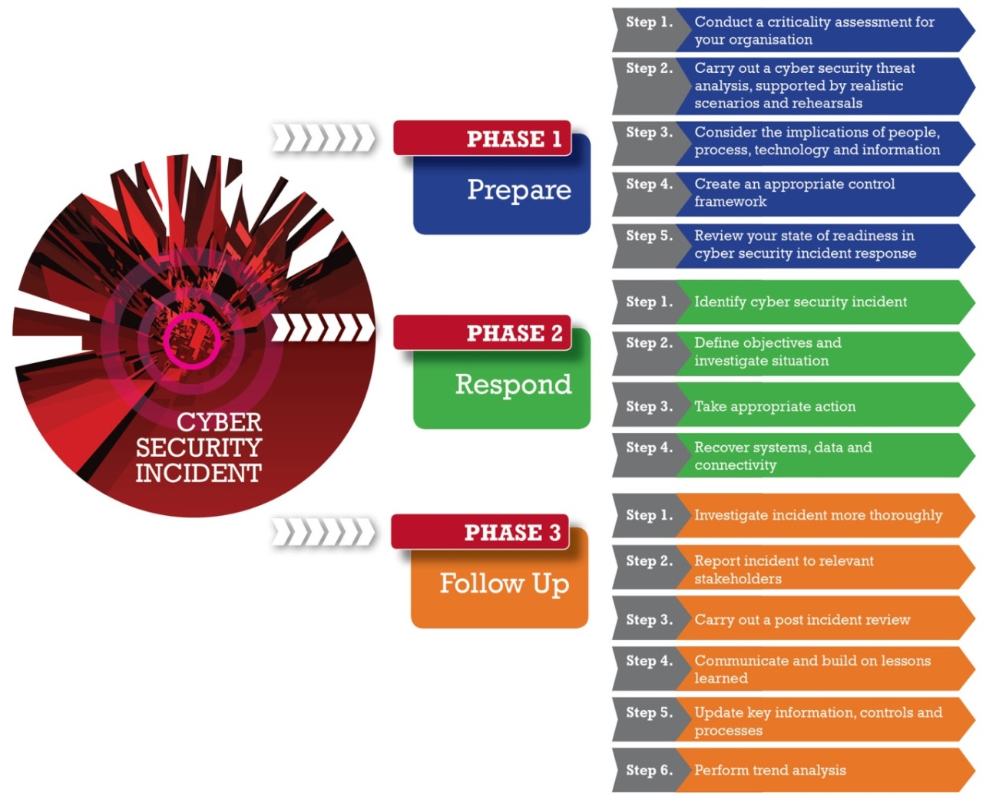
Incident Response and Forensics
Session 11
Security+
Incident Response
Incident Response Plan
Planning and Preparation – establish policies and procedures for a future incident.
Identification and Evaluation – automated detection of events and incidents. (Intrusion detection systems IDS, and security event manager SEM)
Containment and Mitigation – determine how to contain the damage and how to proceed to the next step
Eradication and Recovery – remove the problem to establish an environment to return to normal processing.
Investigation and Closure – determine what happened, who did it, and how did they do it.
Lessons Learned – determine what steps need to be taken to prevent this from happening again.

Slide 16
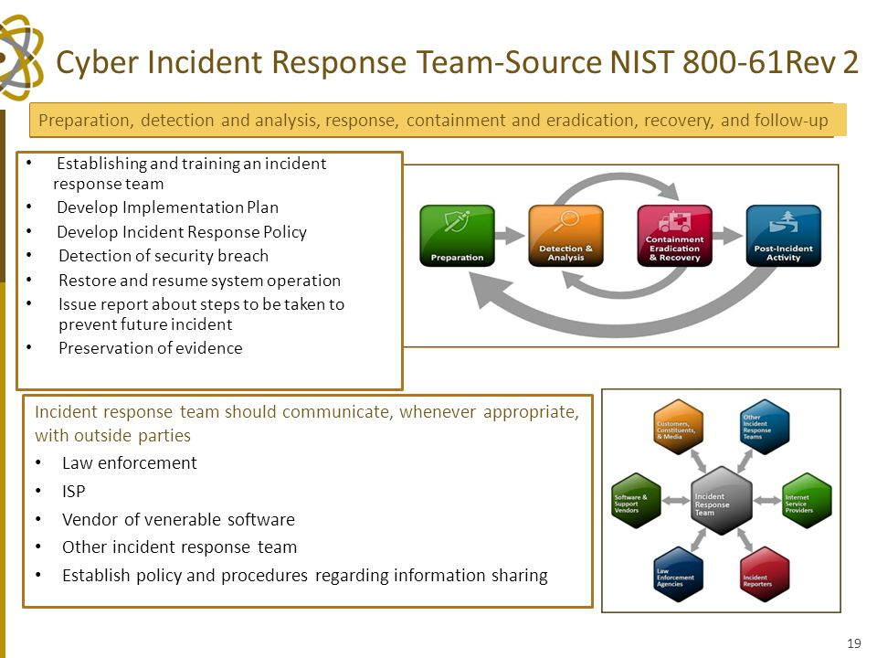
Incident Response and Forensics
Session 11
Security+
Incident Response
Incident Response
Step 1: Identifying the Incident
Through alerts by an IDS / IPS or other devices. Or by monitoring personnel to determine that an incident / breach of the system has occurred.
The incident is the escalated to the Incident Response Team.

Slide 17
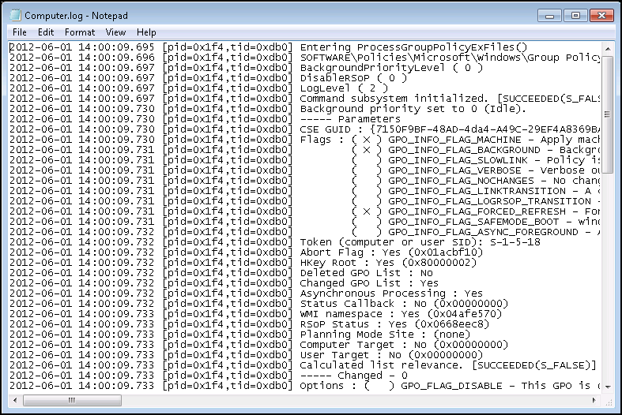
Incident Response and Forensics
Session 11
Security+
Incident Response
Incident Response
Step 2: Investigating the Incident
The Incident Response Team will search logs, files, to determine the nature and scope of the incident, and if it is part of a larger attack, a random event or a false positive.
An IDS system can generate a lot of false positives.

Slide 18


Incident Response and Forensics
Session 11
Security+
Incident Response
Incident Response
Step 3: Recovery/Repairing the Damage
Restoring network service, after DDoS attack, Rebooting all systems.
Virus scans to remove viruses.
Re-imaging, re-installing operating systems and applications.
Change all passwords.
Notify affected parties if data has been stolen.

Slide 19
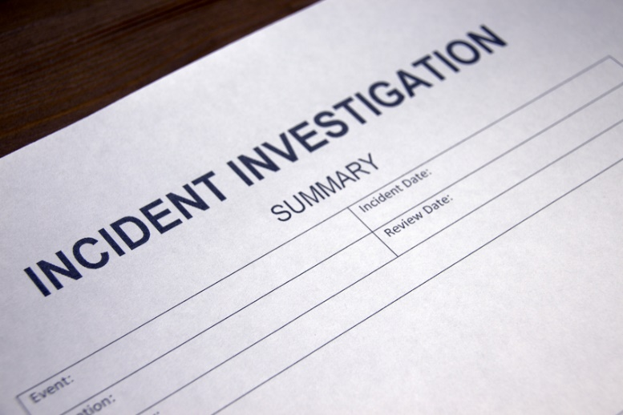
Incident Response and Forensics
Session 11
Security+
Incident Response
Incident Response
Step 4: Documenting and Reporting the Incident
Incident Response Team will document all steps during the incident investigation, detection and recovery.
Report the incident to the CERT (www.cert.org) organization so others can be aware of the type of attack and proactive measures to take.
Report the incident to legal authorities if appropriate.

Slide 20
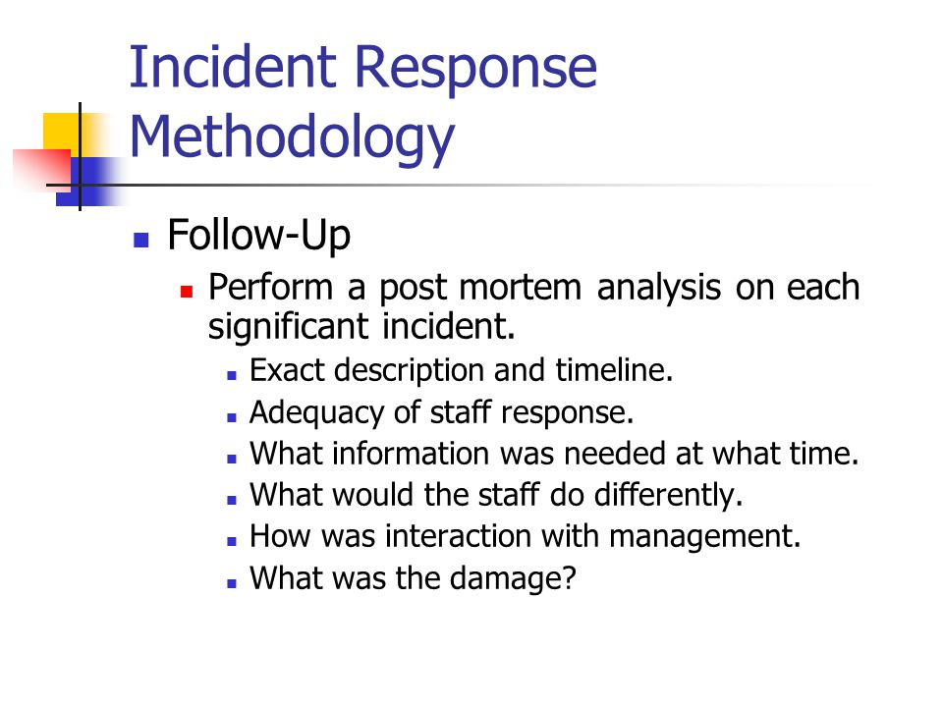
Incident Response and Forensics
Session 11
Security+
Incident Response
Incident Response
Step 5: Adjusting Procedures
Review policies and procedures to determine what needs to be changed to prevent the incident or be able to detect sooner.
Review Lessons Learned with Incident Response Team and management.

Slide 21
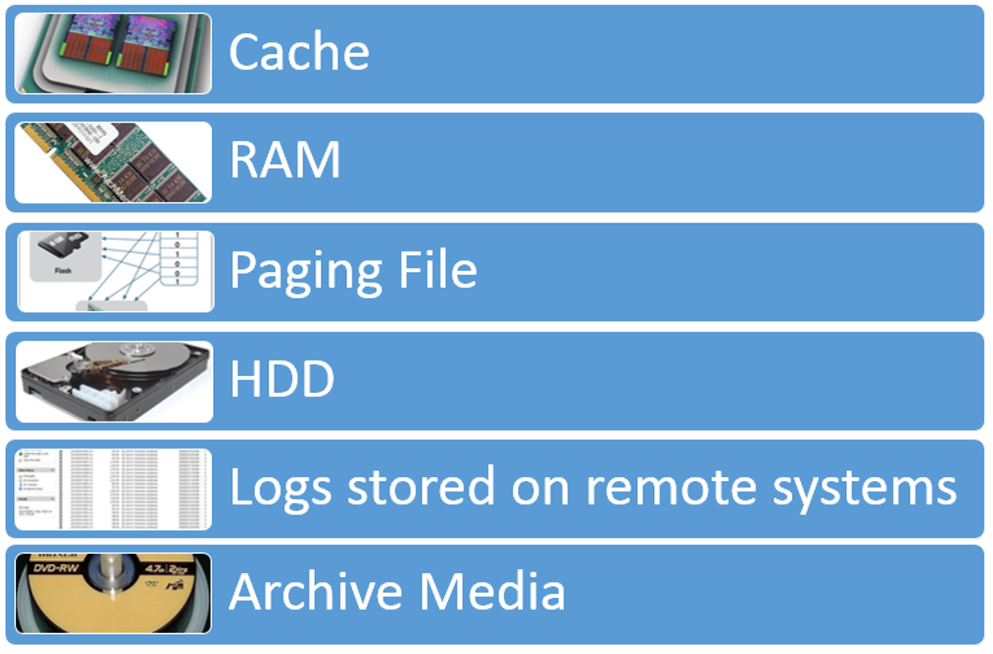
Session 11
Incident Response and Forensics
Security+
Forensics
Forensics
Order of Volatility – the order in which an incident or investigation would occur.
Move from the most to least volatility to capture data for forensic review.

Slide 22
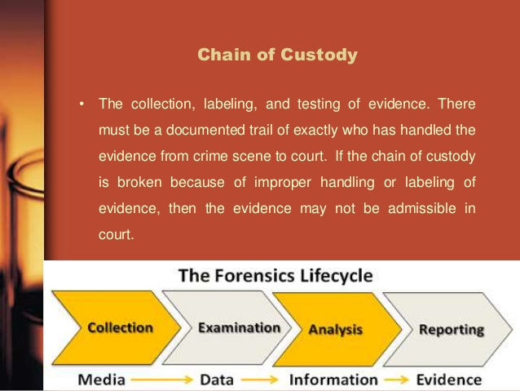
Session 11
Incident Response and Forensics
Security+
Forensics
Forensics
Chain of Custody – addresses the reliability and credibility of evidence in a legal proceeding.
Who collected the evidence, where was the evidence collected, how was it collected, and who had possession of the evidence at any time?
Chain of Custody has to be maintained and documented in order for evidence to be allowed and admissible in legal proceedings.

Slide 23
Incident Response and Forensics
Session 11
Security+
Business Continuity
Knowledge Check 3
Joe a computer forensic technician responds to an active compromise of a database server. Joe first collects information in memory, then collects network traffic and finally conducts an image of the hard drive.
Which of the following procedures did Joe follow?
A. Order of volatility
B. Chain of custody
C. Recovery procedure
D. Incident isolation

Slide 24
Incident Response and Forensics
Session 11
Security+
Common Ports and Protocols
Port | Service name | Transport protocol
20, 21 | File Transfer Protocol (FTP) | TCP
22 | Secure Shell (SSH) | TCP and UDP
23 | Telnet | TCP
25 | Simple Mail Transfer Protocol (SMTP) | TCP
50, 51 | IPSec
53 | Domain Name Server (DNS) | TCP and UDP
67, 68 | Dynamic Host Configuration Protocol (DHCP) | UDP
69 | Trivial File Transfer Protocol (TFTP) | UDP
80 | HyperText Transfer Protocol (HTTP) | TCP
110 | Post Office Protocol (POP3) | TCP
119 | Network News Transport Protocol (NNTP) | TCP
123 | Network Time Protocol (NTP) | UDP
135-139 | NetBIOS | TCP and UDP
143 | Internet Message Access Protocol (IMAP4) | TCP and UDP
161, 162 | Simple Network Management Protocol (SNMP) | TCP and UDP
389 | Lightweight Directory Access Protocol | TCP and UDP
443 | HTTP with Secure Sockets Layer (SSL) (HTTPS) | TCP and UDP

Slide 25
Incident Response and Forensics
Session 11
Security+
Business Continuity
Knowledge Check 4
An in-house penetration tester has been asked to evade a new DLP system. The tester plans to exfiltrate data through steganography.
Discovery of which of the following would help catch the tester in the act?
A. Abnormally high numbers of outgoing instant messages that contain obfuscated text
B. Large-capacity USB drives on the tester's desk with encrypted zip files
C. Outgoing emails containing unusually large image files
D. Unusual SFTP connections to a consumer IP address

Slide 26
Incident Response and Forensics
Session 11
Security+
Business Continuity
Knowledge Check 5
Systems administrator and key support staff come together to simulate a hypothetical interruption of service.
The team updates the disaster recovery processes and documentation after meeting.
Which of the following describes the team's efforts?
A. Business impact analysis
B. Continuity of operation
C. Tabletop exercise
D. Order of restoration

Slide 27
Incident Response and Forensics
Session 11
Security+
Thank You!!
Send questions and slide deck requests to:
Jim Reeves
Security+, CASP+,CySA+, CISSP, ITILv3, CTT+
MCSE, MCSD, MCT
jireeves@Deloitte.com

